Slide 1
Milestone 8 – Final report
Notes:
Hi there, my name is DB and I have got the honor of introducing SIMTECH to you. *click*

Slide 2
Content
Introduction
conceptual model
Input data analysis
simulation model
validation
Experiments
Project progress
Cost
Milestone 5 – Simulation Program

Slide 3
Team Goal
“Simtech’s” goal is to efficiently generate a simulation model for building a tramline through Jakobstraße and suggest the best way of handling traffic at Jakobstraße, ”
Milestone 5 – Simulation Program

Slide 4
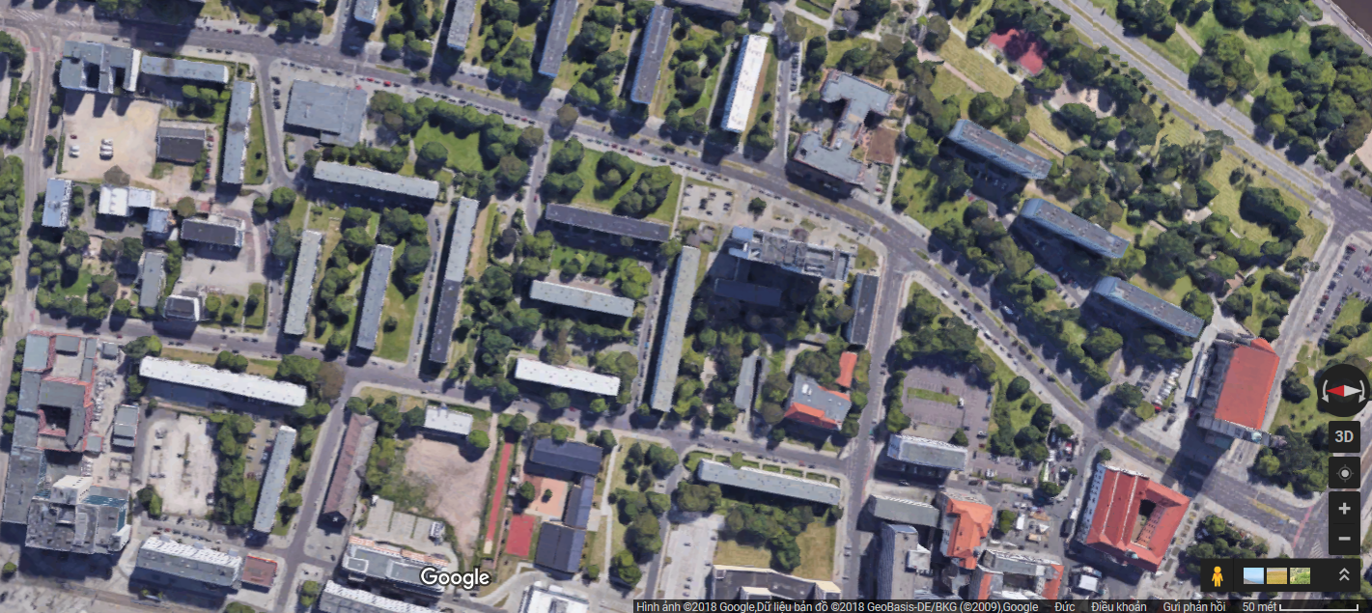
Jakobstraße – bird's eye view
Endpoint North: Listemannstraße
Endpoint south: Vor Ernst-Reuter-Allee
Milestone 7 - Experiments

Slide 5
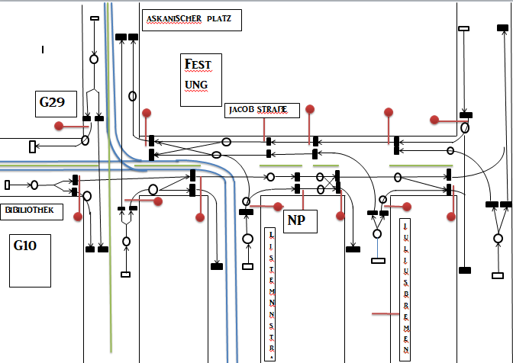
Conceptual model :PetriNet
Milestone 3 – Conceptual Model
Notes:
Simply put: We want to create value for the customer – if we were real consultants, that would be the second highest priority.
First would be getting paid. But as we dont get paid, we still might learn something – getting better at working with strangers for instance, and creating our own frameworks to perform in. From scratch.
This is a sandbox, but an even better one than an internship (which you would do alone) And get grades.
This is what we want to achieve in theory. *click*

Slide 6

Assumptions
StVO Rules
…Speeding
…No accidents
…Infinite patience
Cars & Trams
…Traffic lights
…No trucks, busses, bicycles
…No pedestrians
Space & Time
…Excluding ‘Breiter Weg‘
…No seasonal influences
Milestone 3 – Conceptual Model
Notes:
Simply put: We want to create value for the customer – if we were real consultants, that would be the second highest priority.
First would be getting paid. But as we dont get paid, we still might learn something – getting better at working with strangers for instance, and creating our own frameworks to perform in. From scratch.
This is a sandbox, but an even better one than an internship (which you would do alone) And get grades.
This is what we want to achieve in theory. *click*

Slide 7
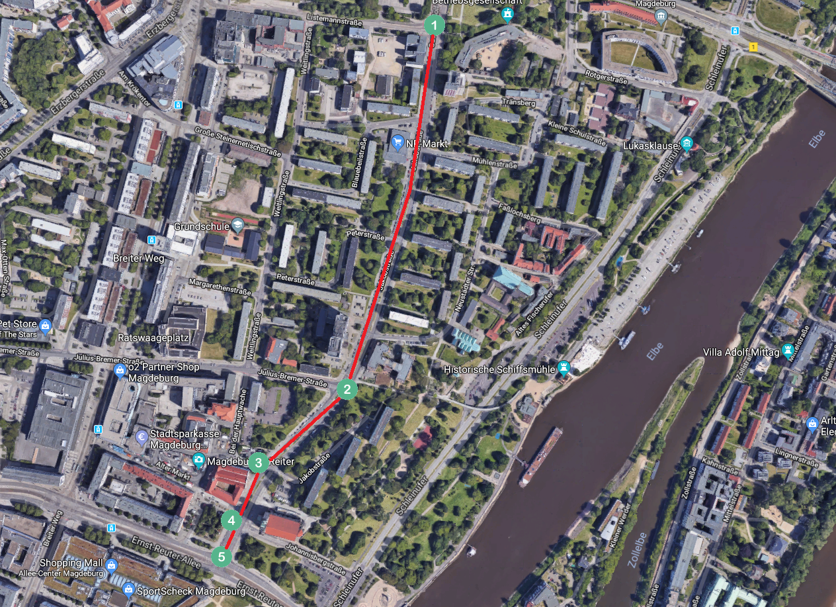
Data Analysis
Milestone 4 – Data Analysis
Notes:
Simply put: We want to create value for the customer – if we were real consultants, that would be the second highest priority.
First would be getting paid. But as we dont get paid, we still might learn something – getting better at working with strangers for instance, and creating our own frameworks to perform in. From scratch.
This is a sandbox, but an even better one than an internship (which you would do alone) And get grades.
This is what we want to achieve in theory. *click*

Slide 8
Input Data
Traffic volumes (number of cars going in and out of the system per hour) – for all important nodes (1, 2, 3, 4 and 5)
Turning probabilities in every possible direction – for inner nodes (2, 3 and 4)
Traffic lights signal timings
The length of the street and its segments between traffic lights and intersections
Speed limit for cars
Milestone 4 – Data Analysis
Notes:
So, who is SIMTECH? After much deliberation, we came up with the following distribution of roles, :
*fingerpointing* Sharath, main Conceptual modeler; Aleksei Baidarov, Pham Huu
Aleksei Baidarov,

Slide 9
Output and Validation Data
Time needed for getting from one entry/exit point to the the other (1->5 and 5->1)
Queue length
Milestone 4 – Data Analysis
Notes:
So, who is SIMTECH? After much deliberation, we came up with the following distribution of roles, :
*fingerpointing* Sharath, main Conceptual modeler; Aleksei Baidarov, Pham Huu
Aleksei Baidarov,

Slide 10
Data Analysis (Traffic volumes at nodes 1, 3, 5)
DTV (Durchschnittlicher täglicher Vehrkehr) = 1.2 * Cars_13h
Cars_13h (Total number of cars from 6.00 to 19.00) = 0.833*DTV
We assume that from 6.00 to 19.00 number of cars has the following distribution:
Time Interval | 6 – 7 | 7 – 8 | 8 – 9 | 9 – 10 | 10 – 11 | 11 – 12
Fraction of cars | 0.045 | 0.068 | 0.065 | 0.070 | 0.071 | 0.075
12 – 13 | 13 – 14 | 14 – 15 | 15 – 16 | 16 – 17 | 17 – 18 | 18 – 19
0.073 | 0.075 | 0.085 | 0.098 | 0.108 | 0.075 | 0.073
Milestone 4 – Data Analysis
Notes:
So, who is SIMTECH? After much deliberation, we came up with the following distribution of roles, :
*fingerpointing* Sharath, main Conceptual modeler; Aleksei Baidarov, Pham Huu
Aleksei Baidarov,

Slide 11
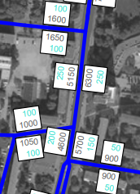
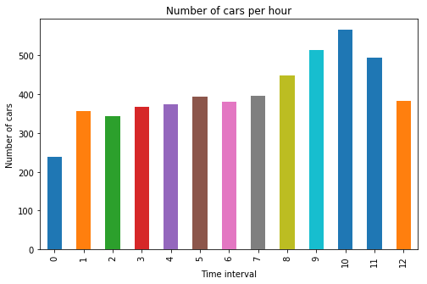
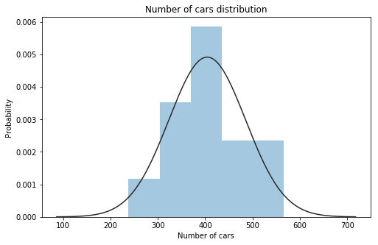
Data Analysis (Traffic volumes at nodes 1, 3, 5) (cont.)
Example:
DTV = 6300 Cars_13h = 0.833*6300 = 5248
Time | 6 – 7 | 7 – 8 | 8 – 9 | 9 – 10 | 10 – 11 | 11 – 12
Cars | 238 | 356 | 343 | 368 | 374 | 394
12 – 13 | 13 – 14 | 14 – 15 | 15 – 16 | 16 – 17 | 17 – 18 | 18 – 19
381 | 396 | 448 | 514 | 566 | 495 | 382
N (404.230, 81.105)
Milestone 4 – Data Analysis
Notes:
So, who is SIMTECH? After much deliberation, we came up with the following distribution of roles, :
*fingerpointing* Sharath, main Conceptual modeler; Aleksei Baidarov, Pham Huu
Aleksei Baidarov,

Slide 12
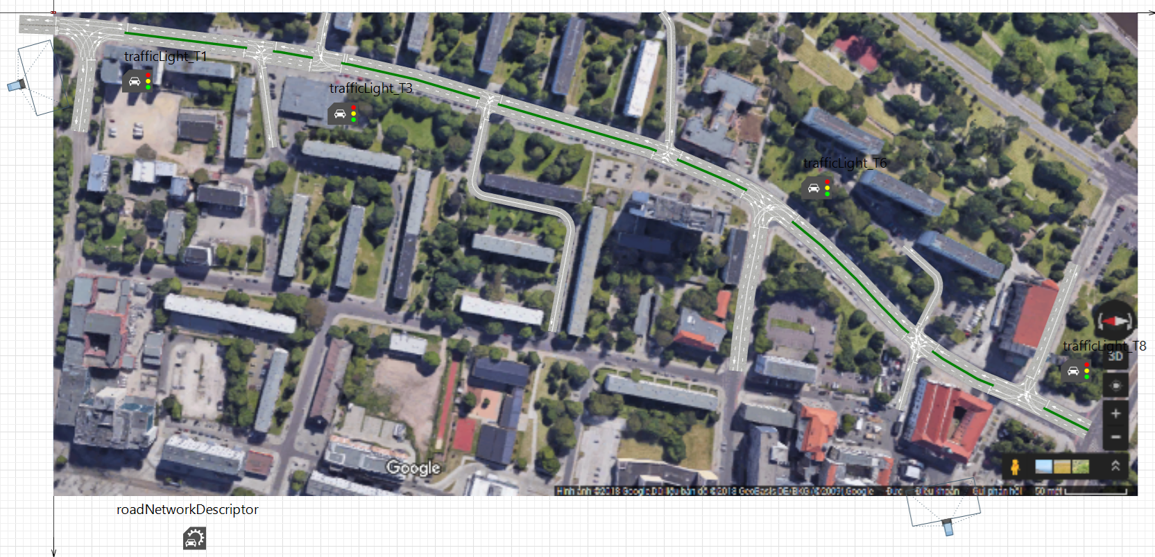
Implementation - Map
Milestone 5 – Simulation Program

Slide 13
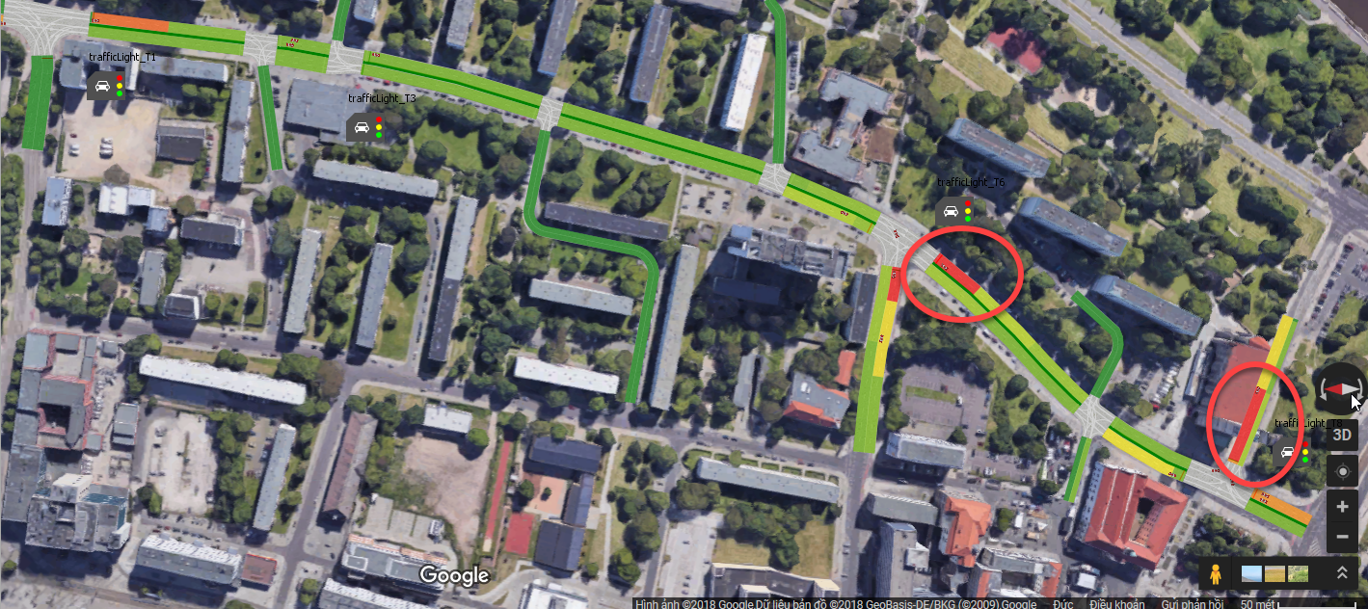
Output Data
Queue Lengths in Johannisbergstraße & at the crossroad of Julius-Bremer-Straße
Travelling time (between Listemannstraße and Johannisbergstraße)

Slide 14
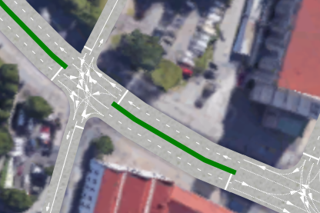
Modifications
Modeling time is changed to 2 hours as rush hours and non rush hours for synchronisation of all car sources
Corrections on turning lanes
Milestone 6 - Validation

Slide 15
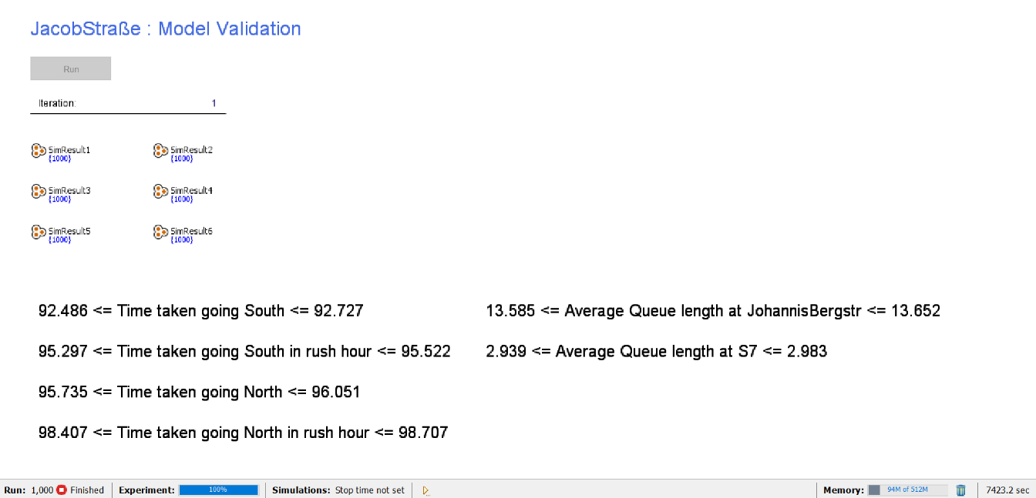
Results of the Validation Experiments
Level of Significance: 0,005
Number of Replications: 1000
Milestone 6 - Validation

Slide 16
Comparisons of Real and Simulated Data
Queue Lengths
 | Johannisbergstraße | Near Julius-Bremer-Straße
Average of Real World Data | 13 | 8,273
Confidence Interval Lower Bound (Simulation Model) | 13,585 | 2,939
Confidence Interval Upper Bound (Simulation Model) | 13,652 | 2,983
Milestone 6 - Validation

Slide 17
Comparisons of Real and Simulated Data
Traveling time (Listemannstraße – Johannisbergstraße)
 | Non-Rush Hours |  | Rush Hours
 | North South | South North | North South | South North
Average of Real World Data | 92,5625 | 97,9375 | 101,1666667 | 92,06666667
Confidence Interval Lower Bound (Simulation Model) | 92,486 | 95,735 | 95,297 | 98,407
Confidence Interval Upper Bound (Simulation Model) | 92,727 | 96,051 | 95,522 | 98,707
Milestone 6 - Validation

Slide 18
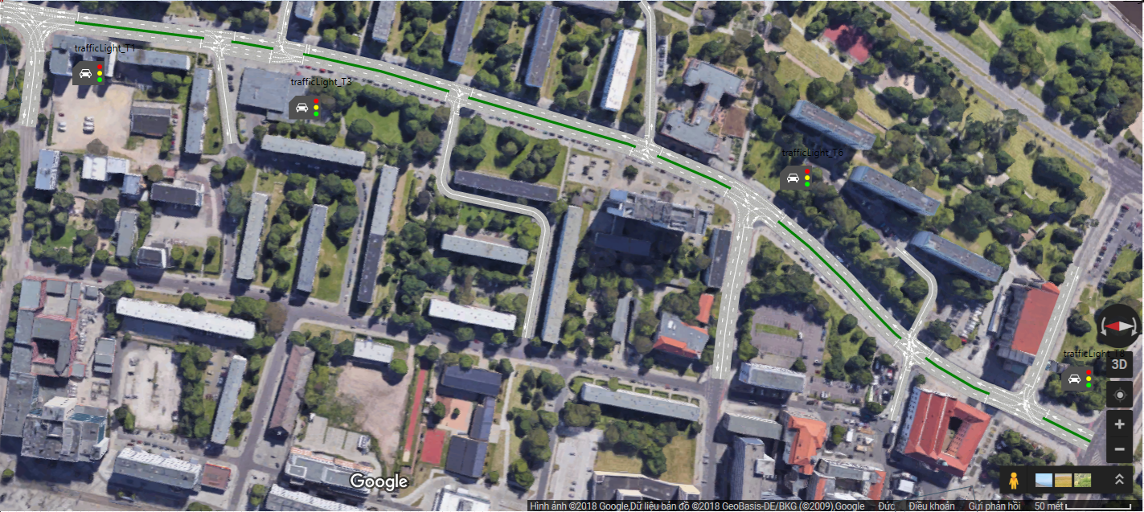
Jakobstraße - Static base model
3 junctions
4 Traffic lights(addition of pedestrian crossing at Mühlenstraße)
Milestone 7 - Experiments

Slide 19
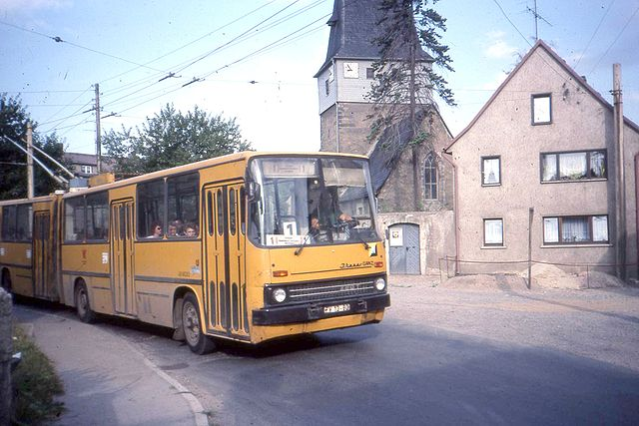
Experiments - Assumptions & Limitations
Assumptions:
Fixed traffic signal timings
Highway code is respected
Only passenger car units
Limitations:
Tram on road(simulation trolley bus)
Wait time at stop: 25 s
(Urheber Felix O, cc-by-sa-2.0, WikiCommons)
Milestone 7 - Experiments

Slide 20
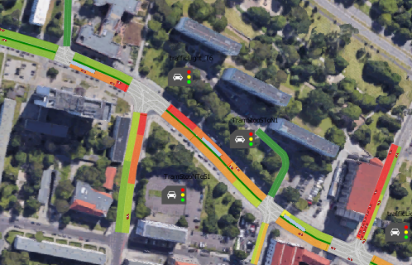
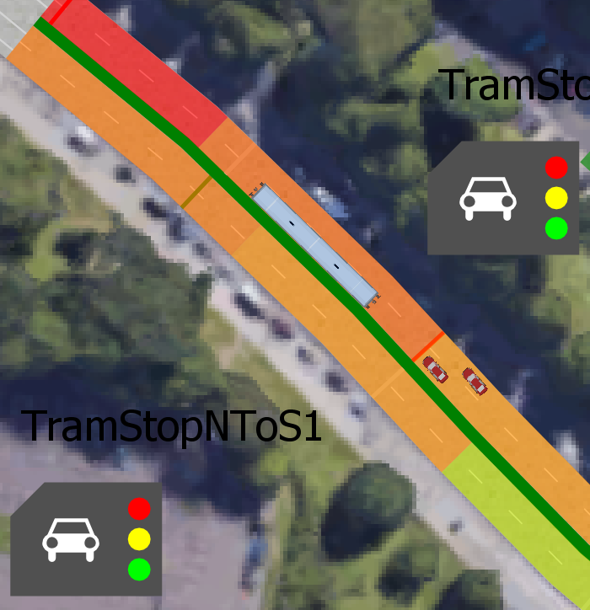
Experiment 1 - stop Julius-Bremer-Straße
Tram station simulated by workaround based on existing traffic light object
→ Stop “dynamic lights“ for all lanes
Simulation Normal situation (6 trams per hour and direction)
Simulation diversion path Breiter Weg (36 trams/hr)
Milestone 7 - Experiments

Slide 21
Experiment 1 - stop Julius-Bremer-Straße
1hour Simulation run normal traffic,1 “Rush Hour“
1000 Simulation runs per each Variant
0,5% significance level
Milestone 7 - Experiments

Slide 22
Ergebnis 1b – Haltestelle Julius-Bremer-Straße
Summary results:
Increase in travel time normally < 2%; Redirection< 20%
Increase in travel time normally < 7%; Umleitung > 50%
→ Expections have been met
Milestone 7 - Experiments

Slide 23
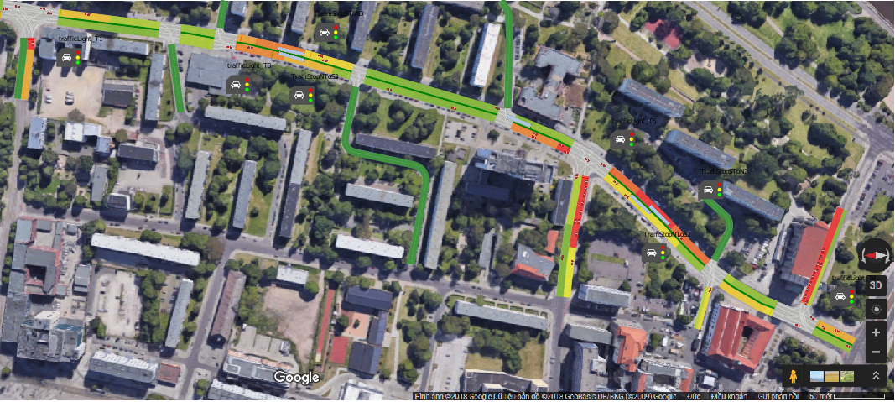
Experiment 2 – 2 stops
Background: More even distribution of stops
Milestone 7 - Experiments

Slide 24
Result 2 - comparison with the first experiment
Boundary conditions as in Experiment 1
Balance against 1st results→ Only additional stop
Milestone 7 - Experiments

Slide 25
Result 2b - 2 stops, interpretation
Summary results:
Increase in travel time is low
Decrease in average queue length (!)
→Result in key figures better than expected
Milestone 7 - Experiments

Slide 26
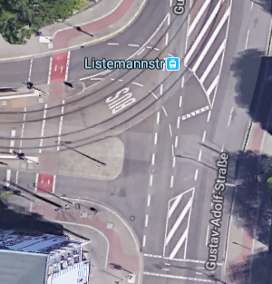
Experiment 3 - "left turn" Listemann road
Background:
So far straight ahead in south – North direction
→Testing alternative layouts expectation:
KPI values between results of Experiment 1 & 2
Implementation:
Add “Turning capability“
→ Results: Expectations with regard compliant KPI values
→ Technical feasibility of track layout
Milestone 7 - Experiments

Slide 27
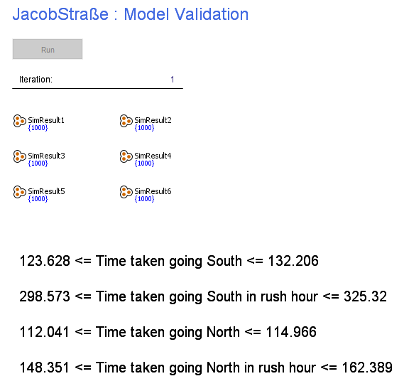
Experiment 4 - Exclusive tram route
Background:
Examining alternative track layout
expectation:
Significant adverse effects on traffic flow
Implementation:
Restriction of normal traffic on single lane
→ Result: Expectations have been met
Milestone 7 - Experiments

Slide 28
Recommendation
Building a tram line through jakobstrasse does not have a great impact on actual traffic situation and external parameters like general traffic volume,throughput.
Thus,we as a team wouldn‘t recommend against building the tram line.
Milestone 7 - Experiments

Slide 29
Project progress: 95%
Milestone 7 - Experiments

Slide 30
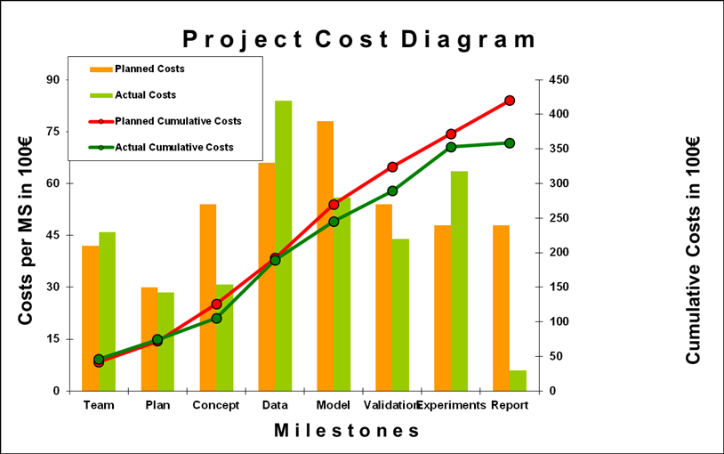
Project Budget 35.275€
Milestone 7 - Experiments

Slide 31
THANK YOU FOR YOUR ATTENTION
Milestone 5 – Simulation Program

